Slide 1
Chapter 11
DNA

Slide 2
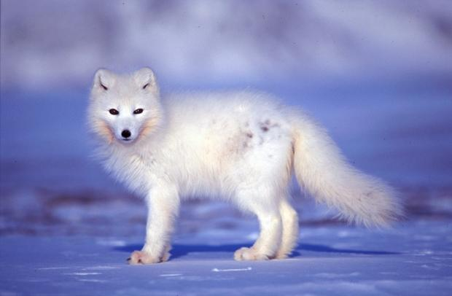
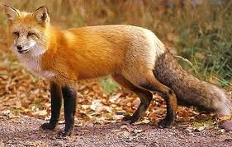
DNA
DNA is the genetic material
Proteins determine traits
DNA → Protein production

Slide 3
DNA history
1928 Griffith
- Studied two varieties of bacterium
(one harmless, one pathogenic)
- killed pathogenic bacteria with heat
- mixed remains with harmless bacteria
- Bacteria was converted to pathogenic form
1952 Alfred Hershey and Martha Chase
DNA or Protein: Which is the genetic material?
T2 with E. coli
radioactive sulfur (Protein contains S)
radioactive phosphorus (DNA contains P)
Results
  Protein (Sulfur medium)
    Little radioactivity found in the cells
  DNA (Phosphorus medium)
    Most radioactivity was found in the bacterial cells
Conclusion
DNA directs host cell to produce additional phage DNA and proteins

Slide 4
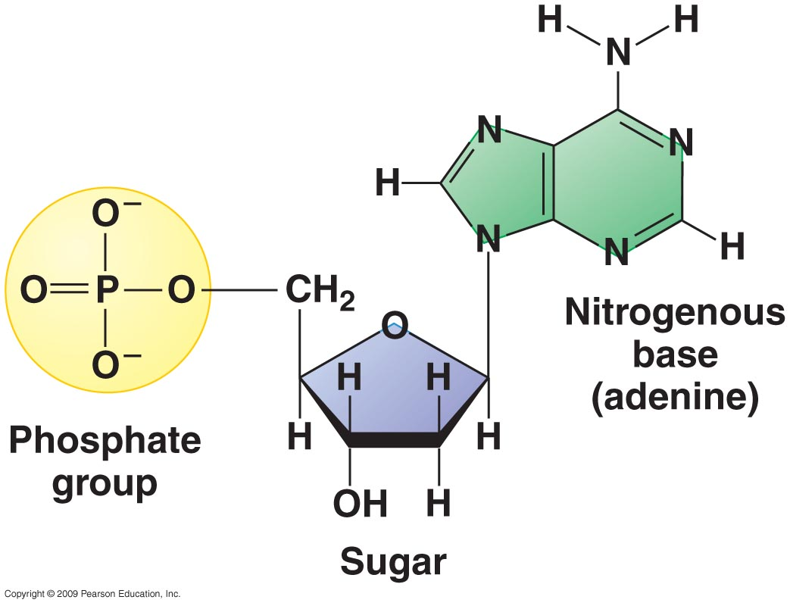
DNA structure
Nucleotides – building blocks of DNA
  Phosphate group
  Sugar
  Nitrogen base

Slide 5
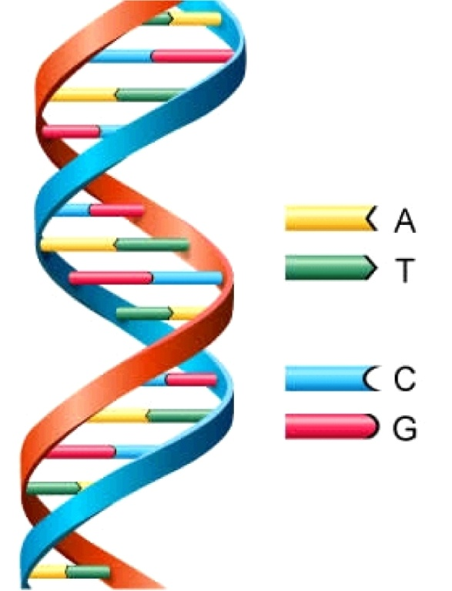
DNA structure
Only 4 nitrogen bases
    Adenine
    Thymine
    Guanine
    Cytosine
  Base Pairs – H-bonds
    A-T
    C-G
  Phosphate of one nucleotide bonds to the sugar of the next

Slide 6
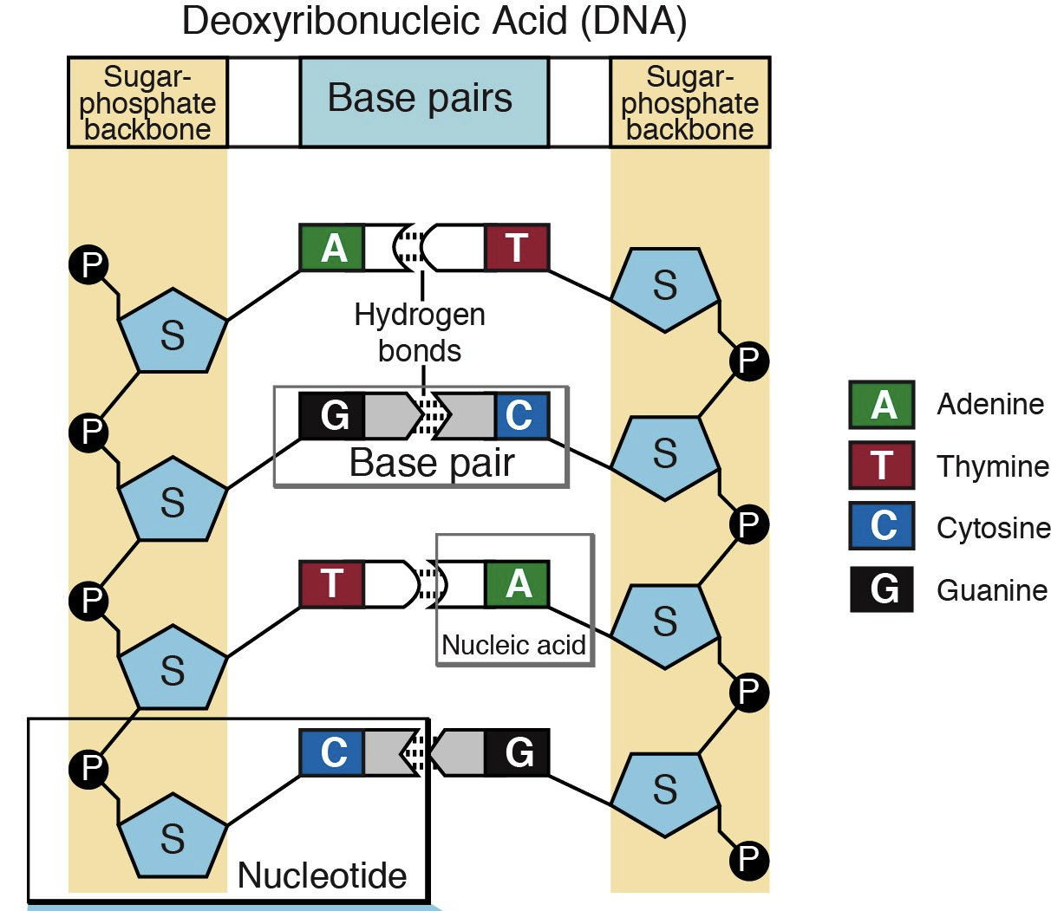

Slide 7
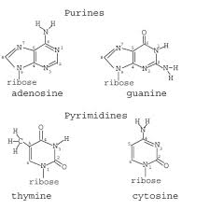
DNA structure
Nitrogen Bases
  Purines- two rings
    Adenine
    Guanine
  Pyramidines- one ring
    Thymine
    Cytosine
  One purine always pairs with a pyramidine

Slide 8
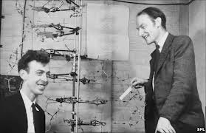
DNA structure
1953 James Watson and Frances Crick
  Proposed the structure of DNA
    Two chains of nucleotides held together by N-bases
    Like teeth in a zipper

Slide 9
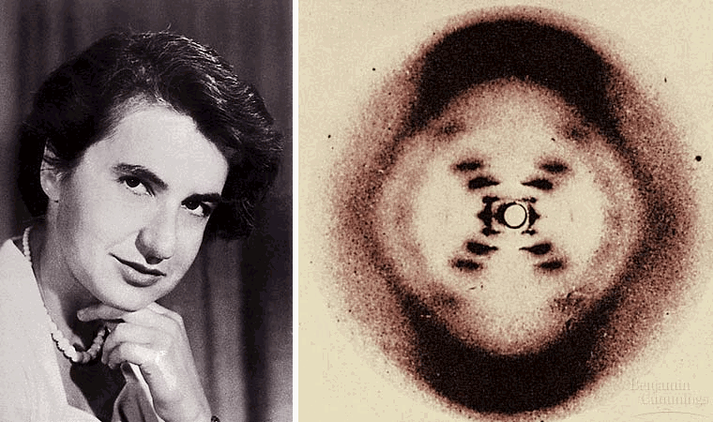
DNA structure
Rosalind Franklin (Earlier in 1953)
  Used x-ray diffraction to prove the double helix was held together by the nitrogen bases
  Watson and Crick had the N-bases on the outside

Slide 10
DNA structure
Nucleotide sequence determines proteins
  Every living thing has the same 4 N-bases
    Adenine, Guanine, Cytosine, Thymine
  How does DNA hold information?
    Order – types of amino acids
    Amount- quantity (black hair has more than blonde)

Slide 11
DNA replication
Sperm- ½ of your DNA (23 chromosomes)
Egg- ½ of your DNA (23 chromosomes)
1 cell → trillions of cells
  Started with the original copy
  Replication- DNA in the chromosomes is copied

Slide 12
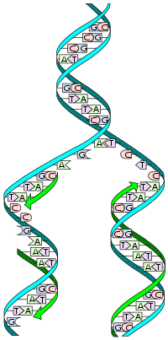
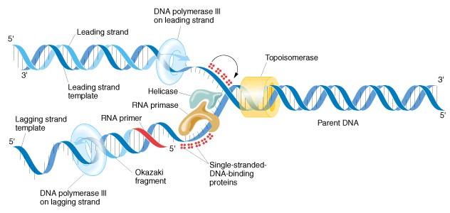
DNA replication

Slide 13
11.2 DNA to Protein
DNA is in the nucleus / Protein production in ribosomes
RNA delivers the message (mRNA)
  3 differences from DNA
    Single helix (half zipper) instead of double
    Ribose sugar instead of deoxyribose
    Uracil instead of Thymine
rRNA – ribosomal
tRNA- delivers amino acids to ribosome

Slide 14
Transcription
DNA (in nucleus)
→ RNA
→Proteins
(Ribosomes in cytoplasm)
Enzymes make an RNA copy of the DNA to send to ribosomes

Slide 15
DNA → RNA
CTAAGCTAGGCTACATTC

Slide 16
ATTACGACTAGCCGATGCACG

Slide 17
GGTACCAATGCGCCATTA

Slide 18
Translation
How do 4 nitrogen bases code for 20 amino acids?
  Codons- groups of three nitrogen bases in mRNA
    4x4x4=64 possible combinations (page 292)
    some proteins have multiple codons
    some codons do not code for proteins
      Start (AUG, methionine)
      Stop (UAA, UAG, UGA)

Slide 19
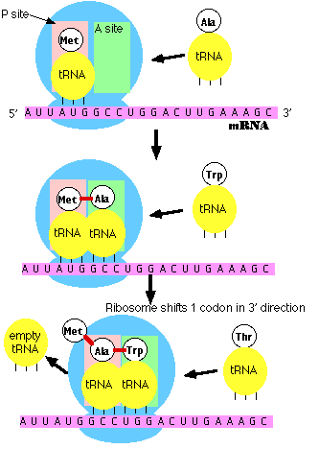
Translation

Slide 20
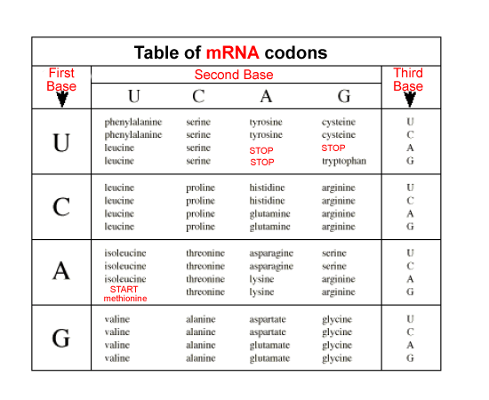
Translation
TACAAAAACAATTATCAATAGAG

Slide 21
Quiz
Transcribe and Translate the following DNA sequence:
ATATACGTGCACCTAATTCGTACC

Slide 22
Monday 11.3 Notes (Mutations)
Tuesday Review Chapter 11
Wednesday Chapter 11 Test

Slide 23
Assignment
11.1 Page 287 #1-5
11.2 Page 295 #1-5

Slide 24
11.3 Genetic Changes
Mutation
  any change in the DNA sequence
  Reproductive cells
    New traits due to altered protein production
      Structural or functional problems
      What if it helps the organism?
        EVOLUTION
  Body Cells
    Radiation, cancer, aging

Slide 25
Types of mutations
Point mutations
  Change in a single base pair in DNA
  Codes for an incorrect amino acid
    THE DOG BIT THE CAT
    THE HOG BIT THE CAT
Frameshift mutations
  Insertion / Deletion of one base
  Changes everything that follows
    THE DOG BIT THE CAT
    THE OGB ITT HEC AT (deletion of the D)

Slide 26
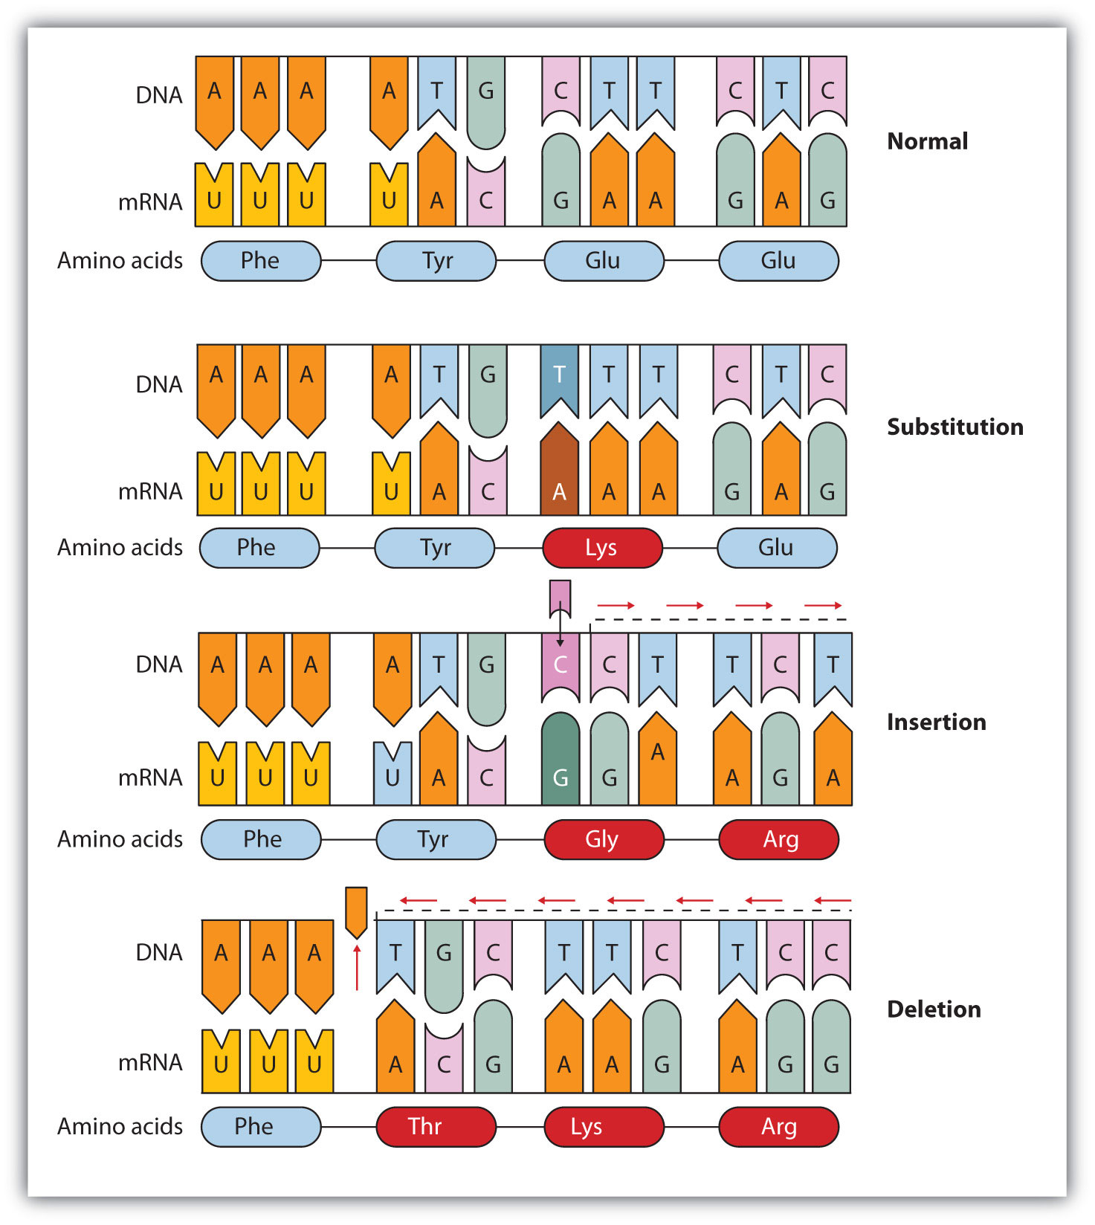

Slide 27
Chromosomal Alterations
Chromosomes break and rejoin incorrectly
  Backward or wrong chromosome
  Deletion, Insertion, Inversion, Translocation
Mutagen- cause of a change in DNA
  Radiation, chemicals, high temperatures
  Asbestos, benzene, formaldehyde
Repairing DNA
  Enzymes repair, but more exposure leads to more mistakes

